Slide 1

Membangun API Menggunakan Slim Framework
Surabaya Bootcamp 2017
Universitas 17 Agustus 1945
6 – 7 Mei 2017

Slide 2
Who Am I
Friandy Dwi Noviandha (Frey)
PHP Developer @ Niagahoster.co.id
(PT. Web Media Technology Indonesia)
github.com/freyandhy
FB : Frey Andhy
freyandhy@gmail.com / frey@hostinger.com

Slide 3
A P I
Application Programming Interface

Slide 4
“ It’s like you can stand on the shoulders of giants, and make some really awesome things. For that you don’t have to do a ton of work and do everything yourself from scratch. “ – Colt Steele

Slide 5

Sekumpulan perintah/function yang dapat dimanfaatkan oleh seorang developer sebagai jembatan untuk berkomunikasi antar Aplikasi.
Connecting Applications

Slide 6
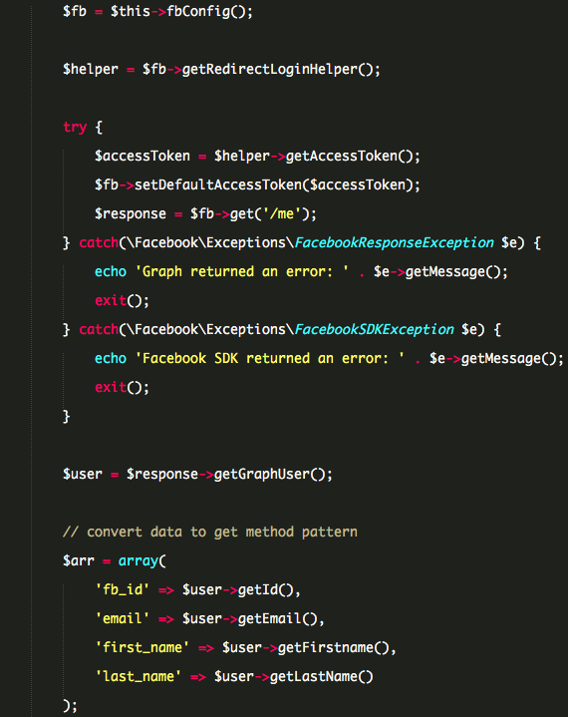

FB, Talk to me !

Slide 7
SIA
Mahasiswa Dosen Fakultas Mata Kuliah
API checkLogin() – getMhs() getFakultas() – getDosen()
SIA versi mobile
Sistem Pendaftaran Wisuda
Aplikasi Perpustakaan

Slide 8

Slim Framework

Slide 9

Slim Framework dibangun oleh Josh Lockhart, seorang senior developer dari newmediacampaigns.com dan Ia adalah “The man behind” PHP The Right Way.

Slide 10
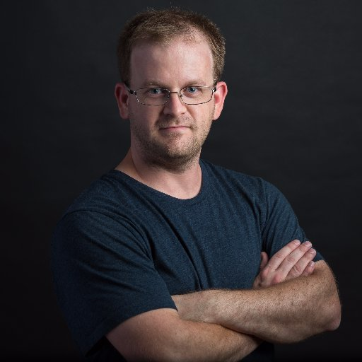
“PHP micro framework that helps PHP developers quickly and easily write web applications and APIs. Think of it as a core set of tools with which a developer can build amazing things."

Slide 11
Instalasi Slim Framework

Slide 12
Slim Framework
Setting up Slim
Setting up Twig
Setting up PSR4 Autoloading
Setting up Controller
Setting up Model
Notes:
Setting up Slim
Struktur Folder
App.php -> routes.php
Setting up Twig
Install Twig
Create View
PSR4 Autoloading
Composer dump-autoload –o
Controller
Set Container

